Slide 1
Question 4 (Total 4 marks)
A part
1.5 marks
Shortest path lengths:
S → B 5
S → C 6
S → D 8
S → E 15
S → F 11
S → G 19
S → H 23
B part
1.5 marks
Order of vertices in which their shortest paths are computed:
B C D F E G H
1 mark
Property of Dijkstra that makes it possible to determine the order

Slide 2
Question 5
4 marks
Routing tables at vertex:
RT@S: (S, -), (B, B), (C, C), (D, C), (E, C), (F, C), (G, C), (H, C)
RT@B: (B, -)
RT@C: (C, -), (D, D), (E, D), (F, F), (G, F), (H, F)
RT@D: (D, -), (E, E)
RT@E: (E, -)
RT@F: (F, -), (G, G), (H, G)

Slide 3
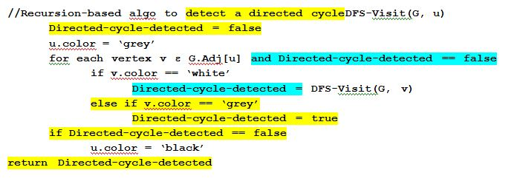
Question 6
5 marks
A part: 2 marks
If one encounters a ‘grey’ vertex while doing a DFS search, it is sure sign of a directed cycle search
B part: 3 marks

Slide 4
Question 7 (total 4 marks)
2 + 2 marks
Constraint on weight of (A,C) so that (A, C) is not on the shortest path from S to C:
5+weight(A, C) >10, or
weight(A, C) > 5
Constraint on weight of (A,C) so that (A, C) is not included in the min spanning tree:
weight(A, C) < 6
THUS, for both these conditions to be met:
5 < weight(A,C) < 6

Slide 5
Question 8: total 4 marks
0 | 1 | 2 | 3 | 4 | 5 | 6 | 7 | 8 | 9 | 10
(11,a) | (121,b) | (100,g) |  | (33,c) | (4,e) | (93,f) |  |  | (75,d) | (1,6)

Slide 6
Question 9: total 6 marks
1
2
3
21|26
22|25
2 marks for DFS tree
2 marks for correct start/finish times
2 marks for correct sequence of courses
1|20
23|24
27|28
6|19
2|5
7|8
11|14
3|4
10|17
15| 16
9|18
12|13

Slide 7
Question 10: 8 marks
Node format:
From|To | down | right.
Matrix G | To 1 | To 2 | To 3 | To 4 | To 5 | To 6
From 1
From 2
From 3
From 4
From 5
From 6
1|2| . | .
1|4| . | .
2|5 | . | .
3|5 | . | .
3|6 | . | .
4|2 | . | .
5|4 | . | .
6|6 | . | .

Slide 8
Question 11: 6 marks, split as 2+2+2
Initially
A, 0
A, 0
May be ignored
C, 8
B, inf
C, inf
B, 2
E,inf
D, inf
F, inf
E,7
D, inf
F, inf
After steps 1, 2, 3
B,2
C, 5
D, 7
E,7
C, 8
E,7
D, 7
E,7
F, inf
F, inf
D, inf
F, inf

